Slide 1





Overview of Global Substance Registration System (GSRS) and Identification of Medicinal Products (IDMP)

Slide 2
Outline of Talk
Organizing Information
IDMP Standard
What is a substance
GInAS/GSRS
Status of Development
Adverse Event Data

Slide 3
Organizing Information
FDA has the most important/valuable repository of human biological and product data but limited integration.
Submission process
Paper
PDF’s
Organizational
Different Centers
Different Contractors
Business Process
The amount of information is increasing
Rapid Screening Methods
Enzyme and Receptor Profiling
Cyp , Transporter and Receptor
Genomics
Epigenomics
Electronic Health Records
Many CMC changes

Slide 4
Organizing Information
Identification of Medicinal Products (IDMP)
ISO project; 5 standards
Approach of the IDMP to organizing information
Goal is to get data organized prior to submission
Fielded data is better than non-fielded Data
Controlled vocabulary is better that non-controlled vocabulary
Codes are better than names in electronic systems particularly relevant to substances
Substance terminology on definitions (truth) not hierarchy
All substances in medicinal products should be be defined and assigned a unique ID

Slide 5
Goals of IDMP Project
Develop a common data structure and terminology for the description of medicinal products
Facilitate data exchange
Pharmacovigilance
Quality of pharmaceutics/detect/prevent counterfeiting
Predict/prevent drug-drug food-drug interactions
Incorporation of diverse data into databases
Prevent drug shortages
Promote Drug Development
Consistent review
Enter once use many (substances, organizations)
Assist in mining of EHRs (Effectiveness. Safety, Better Dosing)

Slide 6
Global Health Benefits of IDMP
Improve Pharmacovigilance
Globally detect safety signals from medicinal products referenced in adverse events
Support Mitigation of Drug Shortages
Allows the identification of pharmaceutically equivalent products across regions
Promote Greater Understanding and Sharing
Supports the exchange of post-market medicinal product information between companies and regulators

Slide 7
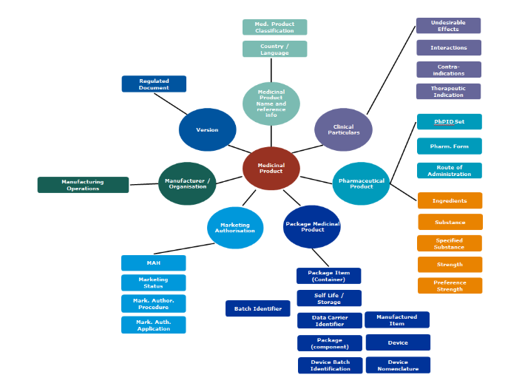
IDMP Overview
http://www.ema.europa.eu/docs/en_GB/document_library/Other/2016/11/WC500217406.pdf

Slide 8
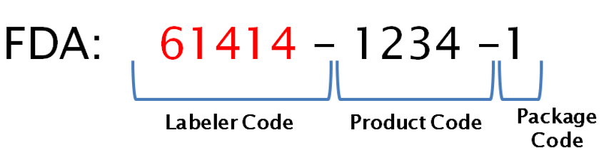



FDA’s Approach to ISO IDMP Standards
)
National Drug Code (NDC)
Medicinal Product
Identification
ISO 11615
MPID = Labeler and Product Codes
Unique Ingredient Identifier (UNII)
ISO 11238
Substance
Identification
Pharmaceutical
Product
Identification
Dosage Form &
Route of Administration
ISO 11616
EU
EDQM
ISO 11239
ISO 11240
Units of Measurement
UCUM

Slide 9



FDA’s Approach to ISO IDMP Standards
Medicinal Product Identification
01
01
U.S. National Drug Code (NDC)
ISO 11615
ISO 11615
ISO
11238
Substance Identification
02
02
Unique Ingredient Identifier (UNII)
ISO
11238
ISO
11240
Units of
Measure
03
03
Unified Code
for Units of Measure (UCUM)
ISO
11240
03
ISO
11239
Dosage Form & Routes of Administration
FDA SPL Terminology
mapped to EDQM
ISO
11239
04
04
ISO
11616
Pharmaceutical Product ID
05
05
Pharmaceutical Product ID
ISO
11616

Slide 10
What is a Substance: ISO 11238
ARISTOTLE (Metaphysics)...the generally recognizable substances... are the sensible substances, and sensible substances all have matter..., and in another sense the formula or form..., and thirdly the complex of matter and form, which alone is generated and destroyed, and is, without qualification, capable of separate existence
A unit of matter that can be quantitatively measured
Five types of substances
Chemicals, Proteins, Nucleic Acids, Polymers, and Structurally Diverse Material
Mixtures
Substance are not defined based on use
The same substance can me manufactured or isolated using different methods

Slide 11
Substances (ISO IDMP)
Five groups of elements are used to describe single substances.
Monodisperse
Chemicals
Defined primarily by molecular structure (connectivity and stereochemistry)
Proteins
Amino Sequence, type of glycosylation, modifications
Nucleic Acids
Sequence, type of sugar and linkage, modifications

Slide 12
Substances (ISO IDMP)
Polydisperse
Polymers (Synthetic or biopolymers)
Structural repeating units, type, geometry, type of copolymer (block or random), ratio of monomers, modifications, molecular weight or properties related to molecular weight, biological source for many biopolymers
Structurally Diverse Substances (viruses, cells, tissues, complex materials)
Taxonomic, anatomical, fractionation, physical properties, modifications

Slide 13
Why Register Substances
Need to tie substances to regulatory submissions
Enhance review and drug development
Active substance and inactive substances under review
Biomarkers can be defined and tracked
Use substances and related substance information to structure submissions
Quality
Manufacturing
In-vitro data
Clinical Information
Clinical trial registration
ICSR
Starting materials
Processing materials
ImpuritieS
Need to tie substances to other substances
Relationships between substances
Active Moiety
Salt/Solvate-> Parent relationships
Metabolites
Impurities
Drug target
Metabolic Enzymes (substrate, inhibitor, inducer)
Transporters (substrate, inhibitor, inducer)
Off target enzymes and receptors

Slide 14
Why Register Substances?
Need to tie substances to products
Quality perspective
Change in substance can lead to a change in product
Find all products that could contain a “bad” ingredient (heparin, diethylene glycol)
Consistent specifications
Safety perspective
Track adverse events based on substances
Tie substances to targets and pathways
Drug Utilization
Predict and prevent shortages
Global marketplace need a global systems substances to manufacturer
Quality
Who makes it
Where they make it
How they make it
Coordinate Inspections and testing
Need to tie substances to manufacturer

Slide 15
Tie Substances to other Information
Need to tie substances to other information
Quality
Characterization
Specifications
Stability
Physical Properties
Molecular weight
Solubility
pKa or pKb
Partition coefficients
Polymorph (crystal, amorphous)
Toxicology and Animal Pharmacology
Genotoxicity
Cellular Cytoxicity
Summary Animal Toxicology
Acute , Subchronic and Chronic
NOAEL, tissue distribution
Environmental Fate
Lab on a Chip results
Clinical Pharmacology (LADMER)
Dissolution Data
Pharmacokinetics (Cmax, Tmax, Half-life, Vd, etc.)
Metabolism
Excretion
Pharmacodynamics
Health and Disease
Indications (treatment, prevention, causative)
Adverse Events
Drug-Drug Interactions
Drug-Food Interactions
Health Outcomes
- omics

Slide 16
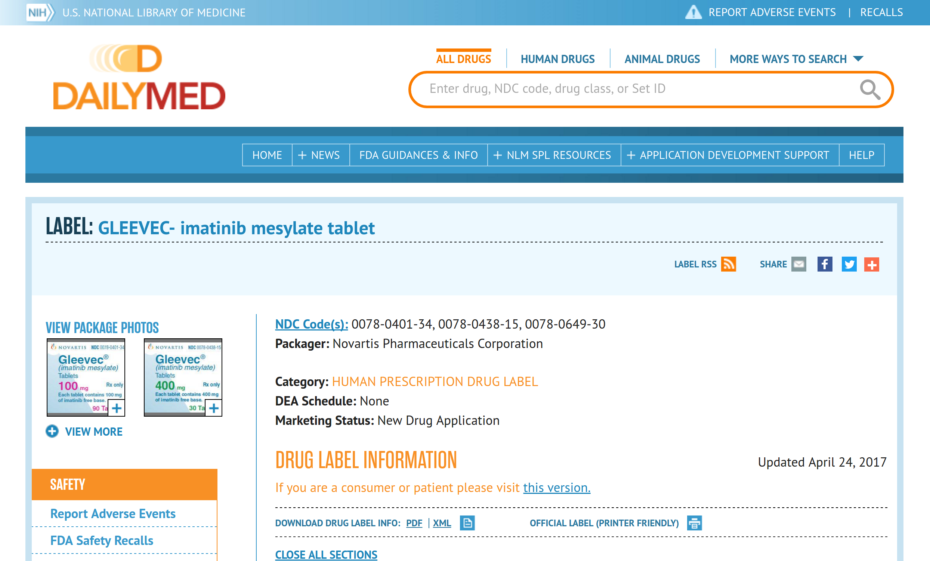
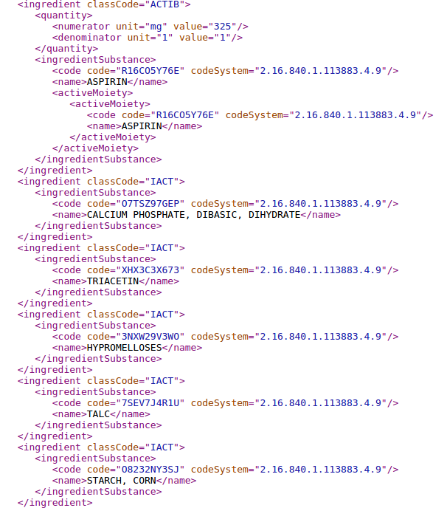
How it’s used at FDA
FDA has adapted GSRS to integrate with existing internal databases and systems.
Adverse events
Products
Applications (INDs, NDAs)
Clinical Trials
Industry uses the data from GSRS to find the UNII codes for their substances, which are submitted to the FDA.
In the future, they will be able to create a JSON message defining their substance to the FDA
Active Ingredient
“Inactive” Ingredients

Slide 17
Need for Specified Substance
Organize additional information on ingredients (SSG1).
Need to describe multiple substance ingredients (Simethicone, Colorants, Flavors)
Need to describe extracts (allergenic and herbal extracts, tinctures)
Need to distinguish materials that differ by physical form or critical properties (Polymorphs, Flowability, Compressibility)
Just starting to implement this at FDA

Slide 18
Need for Specified Substance
Need to tie material to a manufacturer and a process (SSG2 and SSG4)
Need to tie material to a specific grade (SSG3)
Need to obtain specification information (SSG4)
Need to obtain information about processing materials (SSG4)
Need to establish and monitor the supply chain (SSG2)
Manufacturing and specifications were separated out in ISO version 2

Slide 19
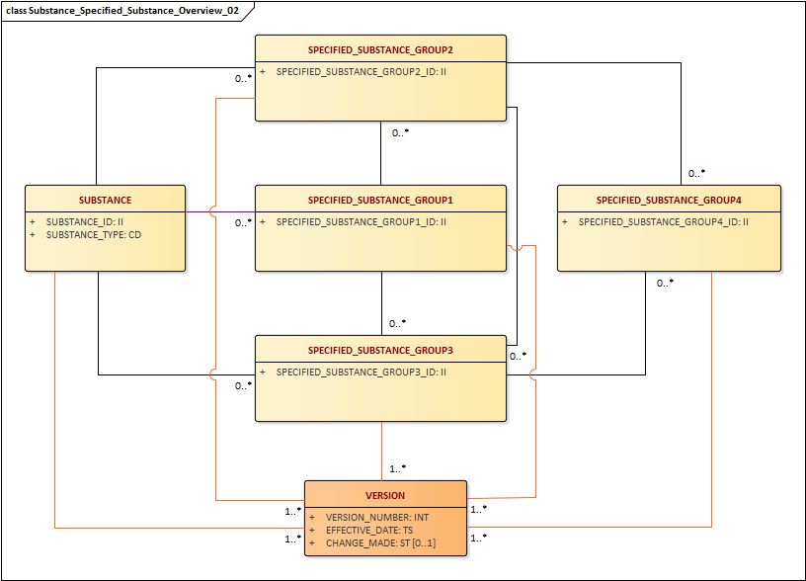
Specified Substance

Slide 20
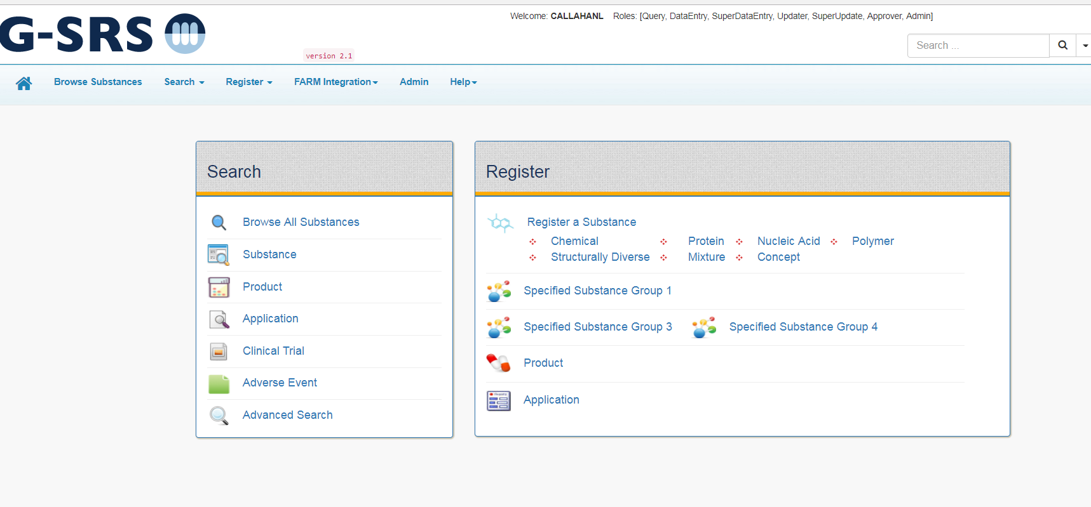

What is the GSRS?
Assigns permanent UNII code to each substance
Compliant with the ISO IDMP Standard
Ties substances to:
Products
applications (Integrity, CFSAN and GSRS)
clinical trials (CT.gov and EUCT)
Adverse events counts
Drug targets
Limited quality information
Registers and defines
Limited LADMER data (metabolites, cyp, transporter info)
GSRS is part of the IDMP effort

Slide 21
GSRS
Global Substance Registration System
Global marketplace for ingredients requires a global system to monitor the global supply chain
A Global Repository of Regulatory Information and Data on Ingredients (Shortages, substandard and counterfeit ingredients, coordinate inspections)
Standard is complex, difficult and expensive to implement
Data abstraction and curation is very expensive
Global database means better data, less redundancy, more data, less mapping

Slide 22


GSRS is a Software Application
Freely distributable (NCATS version, substance only)
Predominantly open source
Data accessed and entered through an API
Backend Java, Oracle
Works with Oracle, PostgreSQL, MySQL has built-in H2 database
Has native JSON message can be adapted to HL7-FHIR
UI development Angular 1.0, Scala, Play framework
Extensive use of Lucene Indexes
Implemented Substance, Specified Substance Group 1, 2, 3 and part of Specified Substance Group 4
Excel tools for batch updating and queries

Slide 23
GSRS
GSRS Software
Works in all modern browsers: IE, Chrome, and Firefox
System will be distributed with a large set of curated public domain data and updated periodically
Over 100,000 substances
Over 800,000 names, 800,000 codes (CAS numbers, WHO-ATC, etc)
Links to many outside resource (Chemid, Pubchem, Drug Bank, Orphan Drug etc)
Structure and sequence based searching
Faceted and advanced field-based searching
Data downloadable in a variety of formats JSON, Text, Excel

Slide 24

Where we are going?
Jan 2021
Oct 2019
Develop and deploy
R applications for substance based analysis
Dec 2018
Deploy portal for direct substance registration for industry and other regulators
Begin entering SSG1 data
Nov 2020
Communication Procedures
Jan 2020 – Nov 2020
UI development angular 6
Modify w/Integrity & FAERS product Dictionary
NCATS to distribute
Create robust communications procedures
Software updates to current version of SOLR
Nov 2019
Jun 2019
Oct 2020
Modify internal process for substance communication
key milestones
Oct 2018
Develop distributable
Version of FDA software

Slide 25
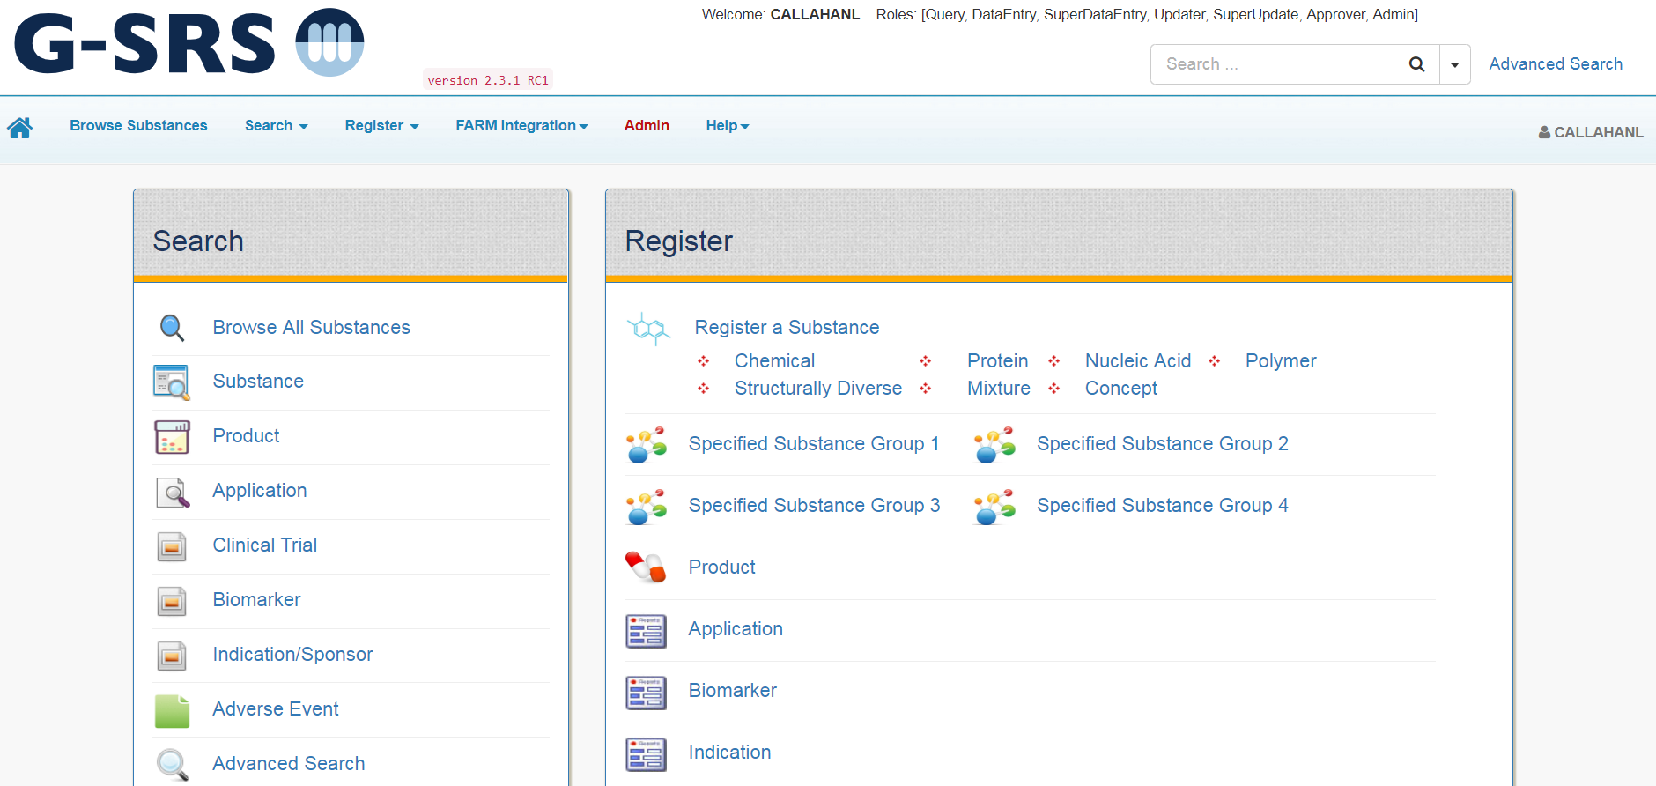

Slide 26
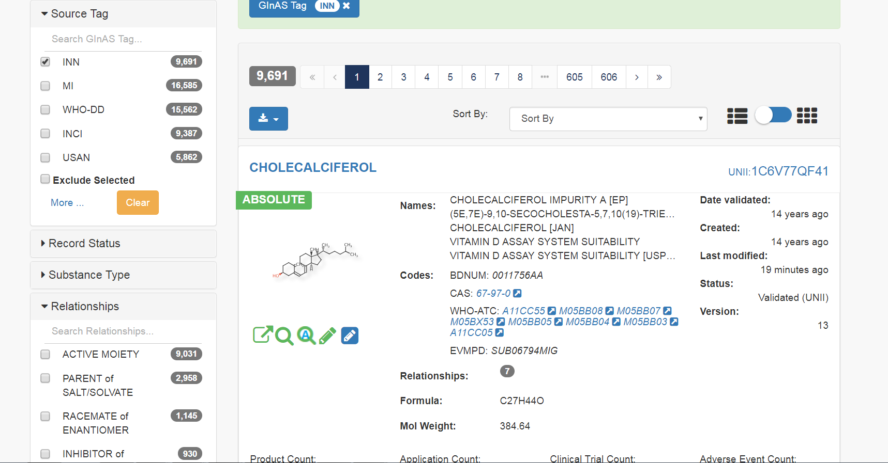

Slide 27
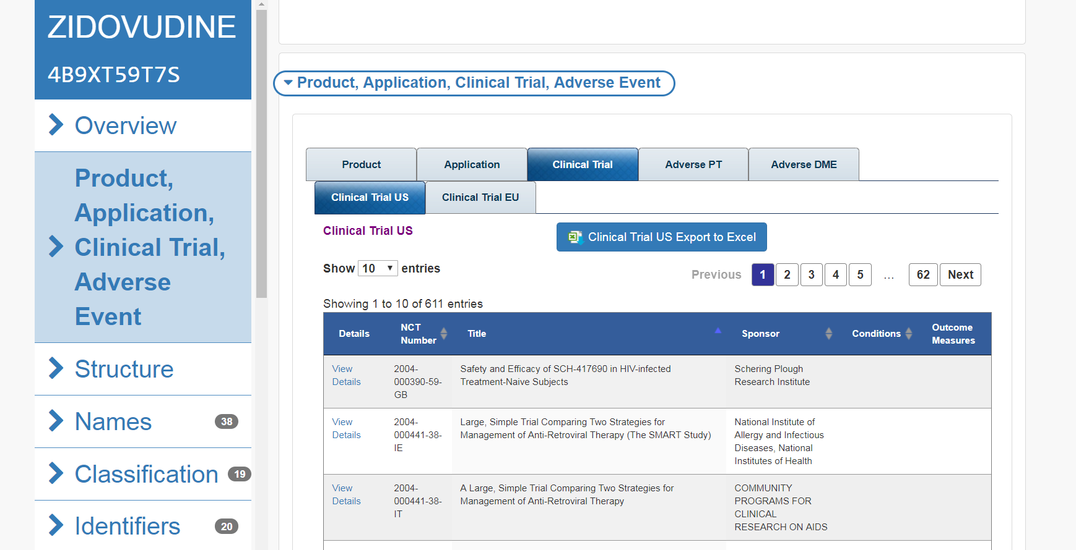

Slide 28
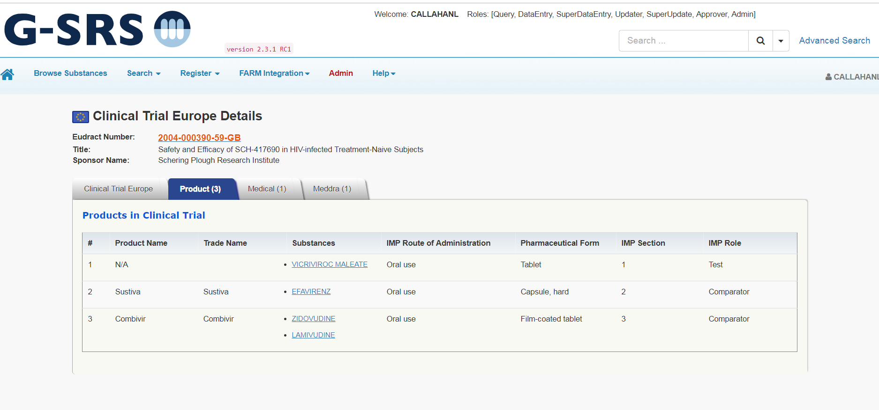

Slide 29
Comparing Adverse Events in G-SRS
FDA product dictionary allows coding of all suspect products to be coded to and active moiety
Counts of adverse events with a given PT term are mapped from product to active moiety
Linking GSRS to FAERS system will allow structure based analysis
Use PRR as a metric of association

Slide 30
What is PRR?
PRR = Proportional Reporting Ratio
is The degree of disproportionate reporting of an AE for a product of
interest compared to this same event for all other products
 | Event Y | All other events
Product X | a | b | a + b
All other products | c | d | c + d
 | a + c | b + d | Total
PRR = [a/(a+b)] / [c/(c+d)]
If PRR >> 1 then Event Y is “disproportionately
reported for Product X
Issues with PRR:
It does not adjust for small counts
Every report represents a suspicion of an AE related to a product

Slide 31
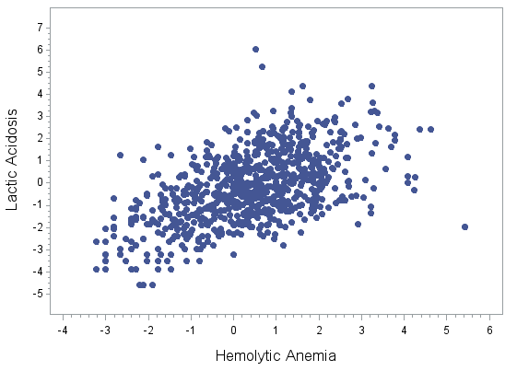
Lactic Acidosis vs. Hemolytic Anemia Outliers
PHENFORMIN
PHENFORMIN
METFORMIN
METFORMIN
METHYLDOPA

Slide 32
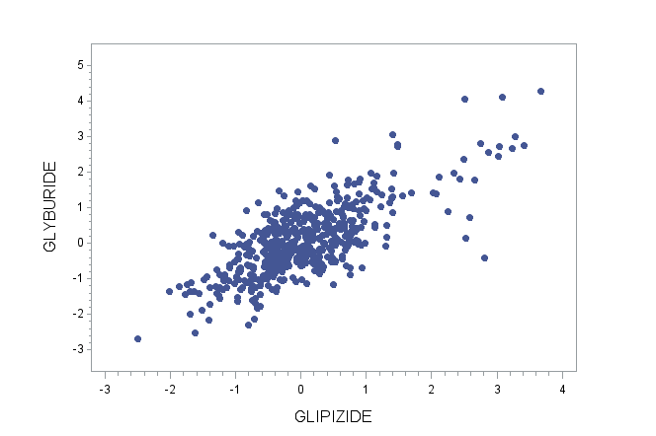
GLYBURIDE vs. GLIPIZIDE Outliers
Drug Tolerance
Increased
Medication
Residue Present

Slide 33
PT-Terms of the Top 5% PRR -- Sulfonylurea Drugs
 | GLICLAZIDE (N=2827) | PT COUNT
1 | HYPOGLYCAEMIA | 548
2 | LACTIC ACIDOSIS | 152
3 | METABOLIC ACIDOSIS | 119
4 | DIABETES MELLITUS INADEQUATE CONTROL | 117
5 | HYPERKALAEMIA | 95
6 | HYPOGLYCAEMIC COMA | 63
7 | PANCREATIC CARCINOMA | 41
8 | PEMPHIGOID | 38
9 | HYPERLACTACIDAEMIA | 33
10 | ACIDOSIS | 31
11 | DIABETIC METABOLIC DECOMPENSATION | 31
12 | BRADYPHRENIA | 23
13 | HEPATITIS CHOLESTATIC | 16
14 | GASTROINTESTINAL MOTILITY DISORDER | 15
15 | VOMITING PROJECTILE | 15
16 | CARDIOACTIVE DRUG LEVEL INCREASED | 14
17 | DISTRIBUTIVE SHOCK | 14
18 | HAEMOGLOBIN INCREASED | 14
19 | HAND DEFORMITY | 14
20 | JOINT NOISE | 14
21 | SCOLIOSIS | 14
22 | BRONCHIECTASIS | 13
23 | POISONING DELIBERATE | 13
24 | PULSE ABNORMAL | 13
25 | HEPATITIS FULMINANT | 12
26 | LICHEN PLANUS | 12
27 | NORMOCHROMIC NORMOCYTIC ANAEMIA | 12
28 | IDIOPATHIC PULMONARY FIBROSIS | 11
29 | URINARY TRACT DISCOMFORT | 10
30 | BRADYKINESIA | 8
31 | DIABETIC HYPEROSMOLAR COMA | 8
32 | SLEEP TERROR | 8
33 | FOETAL DISORDER | 7
34 | JEALOUS DELUSION | 7
35 | RIGHT VENTRICULAR DYSFUNCTION | 7
36 | ACUTE LUNG INJURY | 6
37 | IMPULSE-CONTROL DISORDER | 6
38 | INHIBITORY DRUG INTERACTION | 6
39 | ANAEMIA VITAMIN B12 DEFICIENCY | 5
40 | BODY MASS INDEX DECREASED | 5
41 | CALCIPHYLAXIS | 5
42 | DIABETIC KETOSIS | 5
43 | DIABETIC ULCER | 5
44 | HALO VISION | 5
45 | HYPOGLYCAEMIA NEONATAL | 5
46 | ORBITAL OEDEMA | 5
47 | SLOW RESPONSE TO STIMULI | 5
 | GLYBURIDE (N=11205) | PT COUNT
1 | HYPOGLYCAEMIA | 2671
2 | LACTIC ACIDOSIS | 244
3 | DIABETES MELLITUS INADEQUATE CONTROL | 168
4 | HYPOGLYCAEMIC COMA | 114
5 | DRUG TOLERANCE INCREASED | 70
6 | HYPOGLYCAEMIC UNCONSCIOUSNESS | 29
7 | SHOCK HYPOGLYCAEMIC | 25
8 | HYPOGLYCAEMIC ENCEPHALOPATHY | 18
9 | MUCOSAL EROSION | 17
10 | CONGENITAL MUSCULOSKELETAL ANOMALY | 13
11 | OTITIS EXTERNA | 13
12 | QUADRIPARESIS | 13
13 | MACROSOMIA | 12
14 | METABOLIC ALKALOSIS | 12
15 | SCROTAL OEDEMA | 12
16 | NEPHROCALCINOSIS | 11
17 | GRANULOMATOUS LIVER DISEASE | 9
18 | PULMONARY HYPOPLASIA | 9
19 | DRUG CLEARANCE DECREASED | 8
20 | SPINE MALFORMATION | 8
21 | MICROALBUMINURIA | 7
22 | BLOOD GLUCOSE | 6
23 | BLOOD ZINC DECREASED | 6
24 | TYMPANIC MEMBRANE DISORDER | 6
25 | HYPERINSULINAEMIA | 5
26 | INSULIN C-PEPTIDE INCREASED | 5
27 | PLATELET COUNT NORMAL | 5
28 | RIB HYPOPLASIA | 5
29 | TRANSVERSE PRESENTATION | 5
 | GLIPIZIDE (N=9980) | PT COUNT
1 | HYPOGLYCAEMIA | 1358
2 | HYPERGLYCAEMIA | 705
3 | BLOOD GLUCOSE DECREASED | 452
4 | DIABETES MELLITUS INADEQUATE CONTROL | 287
5 | GLYCOSYLATED HAEMOGLOBIN INCREASED | 195
6 | BLOOD GLUCOSE FLUCTUATION | 144
7 | MEDICATION RESIDUE PRESENT | 110
8 | HYPOGLYCAEMIC COMA | 38
9 | GLUCOSE TOLERANCE DECREASED | 13
10 | ACCIDENTAL POISONING | 8
11 | BLOOD GLUCOSE | 7
12 | MEDICAL DEVICE SITE INFECTION | 6
13 | MICROALBUMINURIA | 6
14 | STOOL ANALYSIS ABNORMAL | 6
 | CHLORPROPAMIDE (N=1904) | PT COUNT
1 | HYPOGLYCAEMIA | 222
2 | INAPPROPRIATE ANTIDIURETIC HORMONE SECRETION | 31
3 | JAUNDICE CHOLESTATIC | 31
4 | CORONARY ARTERY BYPASS | 21
5 | CATARACT OPERATION | 11
6 | LEG AMPUTATION | 10
7 | TOE AMPUTATION | 9
8 | VENOUS OCCLUSION | 9
9 | DIABETIC COMPLICATION | 8
10 | DIABETIC COMA | 7
11 | ANGIOPLASTY | 6
 | TOLAZAMIDE (N=1223) | PT COUNT
1 | HYPERGLYCAEMIA | 137
2 | HYPOGLYCAEMIA | 116
3 | AMBLYOPIA | 70
4 | JAUNDICE CHOLESTATIC | 15
5 | INAPPROPRIATE ANTIDIURETIC HORMONE SECRETION | 14
6 | GANGRENE | 11
7 | KETOACIDOSIS | 11
8 | PATHOLOGICAL FRACTURE | 10
9 | GASTROINTESTINAL CARCINOMA | 8

Slide 34


Working Collaboratively
Notes:
It just would have not been possible without the considerable time and energy graciously donated by our subject matter experts, whose vision for a better world but also intimate knowledge about how everything had to work to work, make this whole project come together.

Slide 35
GInAS Meeting
To get the software and data from NCATS
https://tripod.nih.gov/ginas
Fifth Meeting November 16, 2018
At USP 12601 Twinbrook Parkway
Rockville Maryland 20852
Free and Open to Public
To Get on the GInAS Notification List
Contact Danny Katzel at
Daniel.Katzel@nih.gov

Slide 36
Acknowledgements
FDA Team
Yulia Borodina, Larry Callahan, Ramez Ghazzaoui, Elaine Johanson, Samir Lababidi, Mitch Miller, Archana Newatia, Sarah Steman, Frank Switzer, Annette Vernon, Alex Welsch
Foreign Regulatory Participants
Thomas Balzer (BFarM)
Herman Diederik, Marcel Hoefnagel, Bert Kroes, Ciska Matai (MEB)
Takeshi Misu, Izumi Oba (PMDA)
Vik Srivastava, Mary Rapheal (Health Canada)
Philipp Weyerman (Swiss Medic)
Kew Gardens
Bob Alkins, Elizabeth Dauncey
USP
Fouad Atouf, Andrzej Wilk
WHO-UMC
Malin Jakobsson; Malin Flavid
NCATS Team
Dammika Amugoda, Trung Nguyen, Tyler Peryea, Tim Sheils; Dan Katzel; Noel Southall
IDMP Members
Paolo Alcini, Sabine Brosch, Tim Buxton, Ilaria Del Seppia, Panagiotis Telonis (EMA)
Ta-Jen Chen, Randy Levin, Vada Perkins, Mary Ann Slack (FDA)
Christian Hay (GS1)
Pam Cafiero, Surenda Gokhale, William Gregory, Barry Hammond, Manabu Inoue; Kostas Kidos, Andrew Marr, Wolfgang Spiegl (Industry)
Paul Houston (EMA/CDISC)
EDQM
Claude Coune, Chris Jarvis (EDQM)
Excipient Industry
Dave Schonecker, Katherine Ulman

